Slide 1
Oracle PL/SQL

Slide 2
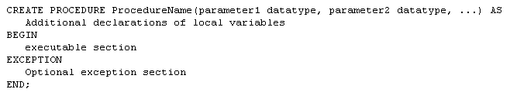
Stored Procedures

Slide 3
Stored Procedures
The first line is called the Procedure Specification
The remainder is the Procedure Body
A procedure is compiled and loaded in the database as an object
Procedures can have parameters passed to them

Slide 4
Stored Procedures
Run a procedure with the PL/SQL EXECUTE command
Parameters are enclosed in parentheses

Slide 5
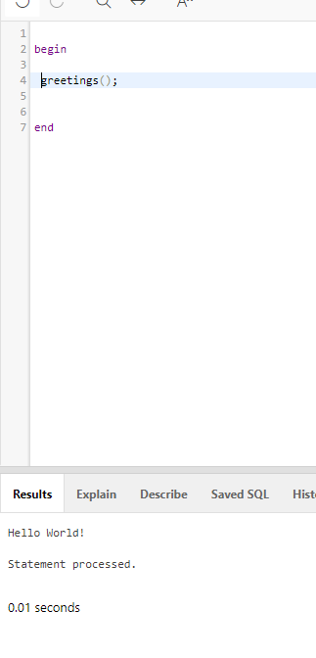
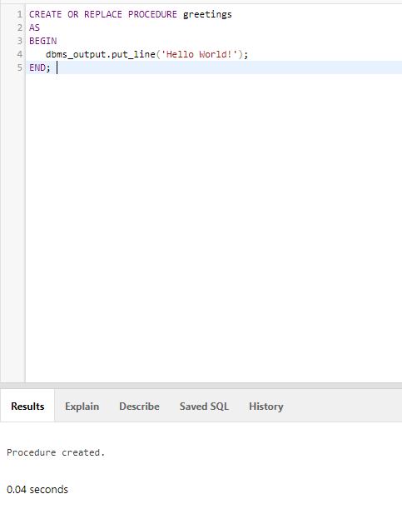
Example of a procedure

Slide 6
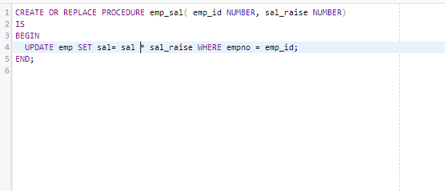
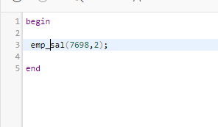
Procedure with parameters

Slide 7
Stored Functions
Like a procedure except they return a single value

Slide 8
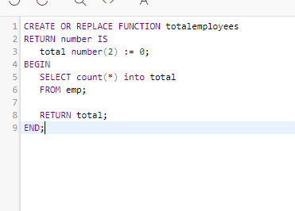
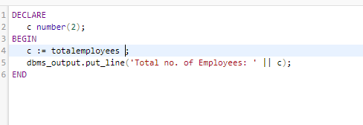
Example of functions
Create the function
Run the function

Slide 9
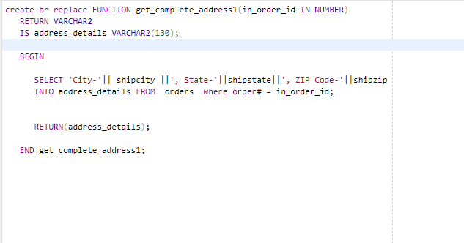
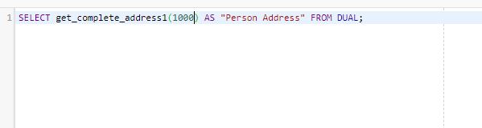
ANOTHER EXAMPLE

Slide 10
Triggers
Associated with a particular table
Automatically executed when a particular event occurs
  Insert
  Update
  Delete
  Others

Slide 11
Triggers vs. Procedures
Procedures are explicitly executed by a user or application
Triggers are implicitly executed (fired) when the triggering event occurs
Triggers should not be used as a lazy way to invoke a procedure as they are fired every time the event occurs

Slide 12
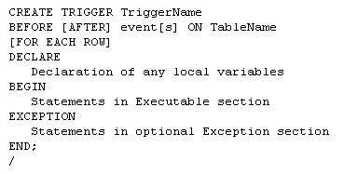
Triggers

Slide 13
Triggers
The trigger specification names the trigger and indicates when it will fire
The trigger body contains the PL/SQL code to accomplish whatever task(s) need to be performed

Slide 14
Triggers

Slide 15
Triggers Timing
A triggers timing has to be specified first
  Before (most common)
    Trigger should be fired before the operation
      i.e. before an insert
  After
    Trigger should be fired after the operation
      i.e. after a delete is performed

Slide 16
Trigger Events
Three types of events are available
  DML events
  DDL events
  Database events

Slide 17
DML Events
Changes to data in a table
  Insert
  Update
  Delete

Slide 18
DDL Events
Changes to the definition of objects
  Tables
  Indexes
  Procedures
  Functions
  Others
    Include CREATE, ALTER and DROP statements on these objects

Slide 19
Database Events
Server Errors
Users Log On or Off
Database Started or Stopped

Slide 20
Trigger DML Events
Can specify one or more events in the specification
  i.e. INSERT OR UPDATE OR DELETE
Can specify one or more columns to be associated with a type of event
  i.e. BEFORE UPDATE OF SID OR SNAME

Slide 21
Table Name
The next item in the trigger is the name of the table to be affected

Slide 22
Trigger Level
Two levels for Triggers
  Row-level trigger
    Requires FOR EACH ROW clause
      If operation affects multiple rows, trigger fires once for each row affected
  Statement-level trigger
  DML triggers should be row-level
  DDL and Database triggers should not be row-level

Slide 23
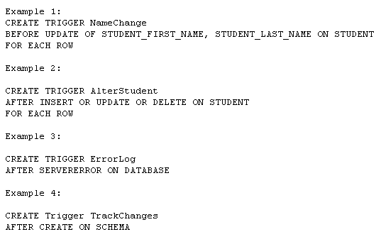
Event Examples

Slide 24
Triggers
Conditions Available So Multiple Operations Can Be Dealt With In Same Trigger
  Inserting, Updating, Deleting
Column Prefixes Allow Identification Of Value Changes
  New, Old

Slide 25
Triggers Exceptions
EXCEPTION Data Type Allows Custom Exceptions
RAISE Allows An Exception To Be Manually Occur
RAISE_APPLICATION_ERROR Allows Termination Using A Custom Error Message
  Must Be Between -20000 and -20999
  Message Can Be Up to 512 Bytes

Slide 26
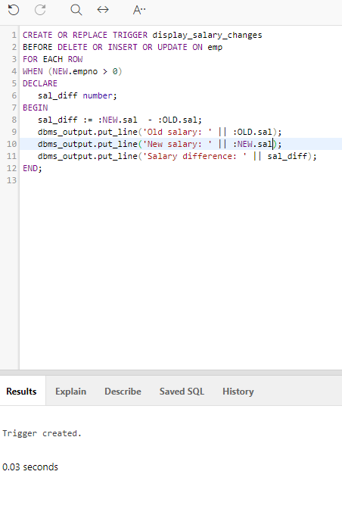
Create the following trigger

Slide 27
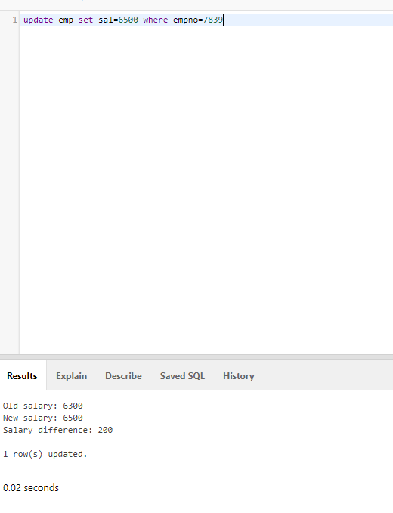
Now update a salary in the emp table

Slide 28
Predefined Exceptions
INVALID_NUMBER (ORA-01722)
  Attempted to store non-numeric data in a variable with a numeric data type
NO_DATA_FOUND (ORA-01403)
  Query resulted in no rows being found
NOT_LOGGED_ON (ORA-01012)
  Not currently connected to an Oracle database
TOO_MANY_ROWS (ORA-01422)
  A SELECT INTO statement returned more than one row

Slide 29
Predefined Exceptions (cont.)
DUP_VALUE_ON_INDEX (ORA-00001)
  Value inserted for a primary key is not unique
VALUE_ERROR (ORA-06502)
  The value being placed in a variable is the wrong length or data type
ZERO_DIVIDE (ORA-01476)
  An attempt was made to divide a number by zero

Slide 30
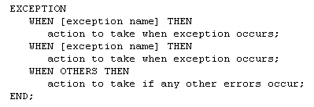
Structure of Exception Section

Slide 31
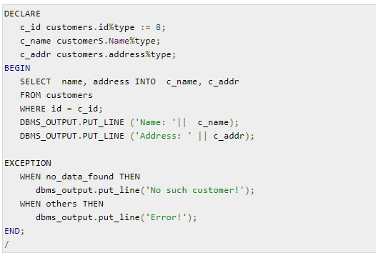
Example

Slide 32

Exercise
Create a procedure that will compute the commission of salesman by multiplying the com rate with 5000. The procedure should display the results.
Create a function that will add 10 to the ship cost in the order table. The function can then executed as follows:
Create a trigger that when the salary in the emp table is updated. A tax computation is shown using the formula new salary * 10.

